Slide 1

Module:4
Basic Science (Physics) (BSP)
GTU # 3110018
Measurements
Prof. Vishal S. Vadgama
Humanities and Science Department
vishal.vadgama@darshan.ac.in
+91 8866118980

Slide 2
Topic
Four – Probe Method
Vander Pauw measurement
Hall effect
Hot point probe measurement
Capacitance Voltage Measurement
Parameter extraction from Diode I.V.
Deep level Transient Spectroscopy (DLTS)
UV – Vis Spectroscopy

Slide 3

Introduction

Slide 4
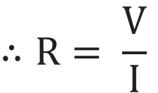
Two Probe Method
Any type of material will have some amount of resistance (R), and by using the equation of ohm’s
law we can measure the resistance of any materials.
$$∴R= \frac{V}{I}$$
There are few techniques to measure the value of resistance for any type of materials.
1) Two Probe Method
2) Four Probe Method

Slide 5


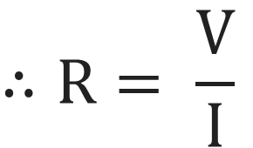

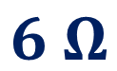

Two Probe Method
Two Probe Method:
V
V
$$∴R= \frac{V}{I}$$
$$1 Ω$$
$$1 Ω$$
I
I
I
I
$$∴R=8 Ω$$
$$6 Ω$$
$$6 Ω$$
The major problem in such method is error due to contact resistance of measuring leads.
The above method cannot be used for materials having random shapes.
For some type of materials soldering the test leads would be difficult.

Slide 6
Two Probe Method
Two Probe Method:
V
V
$$∴R= \frac{V}{I}$$
$$1 Ω$$
$$1 Ω$$
I
I
I
I
$$∴R=8 Ω$$
$$6 Ω$$
$$6 Ω$$
In case of semiconductors, the heating of samples due to soldering results in injection of
impurities into the materials thereby affecting intrinsic electrical resistivity.
In case of semiconductors, contacts between metallic probes and semiconducting sample are not
Ohmic in nature (rather they are of Schottky nature) works as barrier.

Slide 7
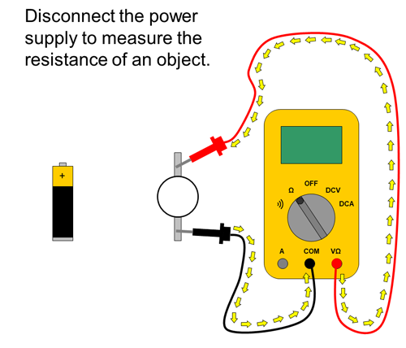
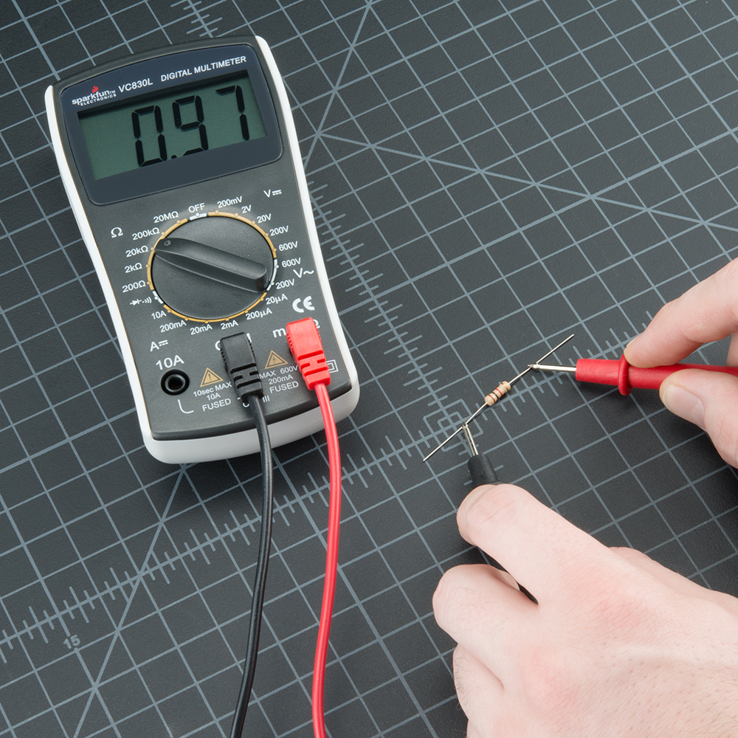
Two Probe Method

Slide 8
Four – Probe Method

Slide 9
Four – Probe Method
Four–probe method, also known as four terminal sensing (4T sensing) or 4–wire sensing is an
electrical impedance measuring technique, that uses separate pairs of current carrying and
voltage sensing electrodes to make more accurate measurements.
It is used to measure the sheet resistance of either a bulk or a thin film specimen.
It uses a set of four probes, distance between each probe is ‘s’.
A current source is connected between the outer two probes and a voltmeter is connected
between the inner two probes.
To measure the resistivity of the sample, a constant current I goes through the two outer probes
and voltage drop between the inner two probes is measured.
A very high impedance voltmeter is used, so current does not flow through the voltmeter, hence
the contact resistance are eliminated.

Slide 10
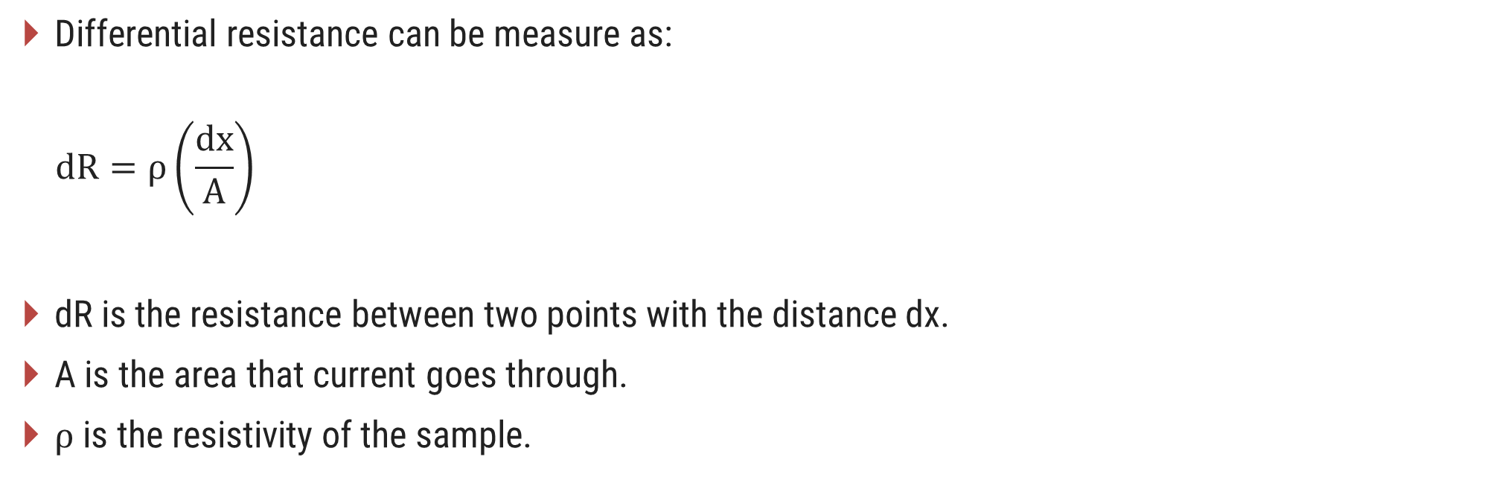
Four – Probe Method
Differential resistance can be measure as:
$$dR=ρ\left(\frac{dx}{A}\right)$$
dR is the resistance between two points with the distance dx.
A is the area that current goes through.
ρ is the resistivity of the sample.

Slide 11
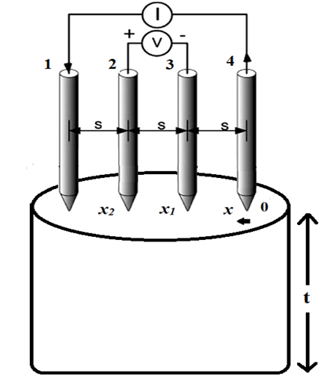
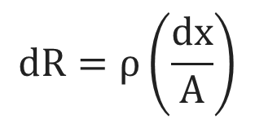
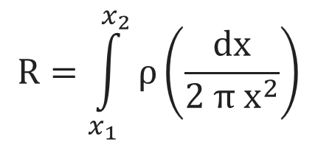
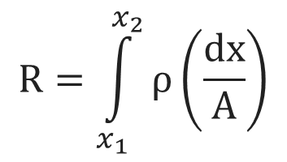
Four – Probe Method
Case: 1 Bulk material (when s << t)
$$dR=ρ\left(\frac{dx}{A}\right)$$
Integrating both the sides,
$$R=\int_{x_{1}}^{x_{2}}{ρ\left(\frac{dx}{A}\right)}$$
$$R=\int_{x_{1}}^{x_{2}}{ρ\left(\frac{dx}{2 π{ x}^{2}}\right)}$$
Area of half hemispherical shell = 2 π x²

Slide 12
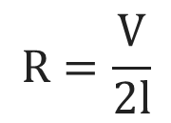
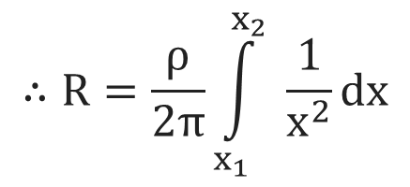
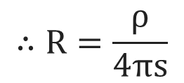
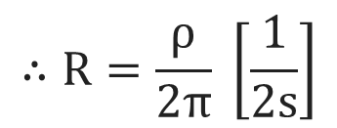
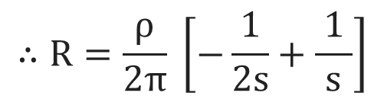
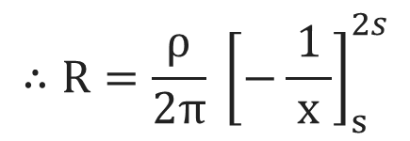
Four – Probe Method
Explanation:
Current is injected through the outer probes it travels outward
from the point of contact through bulk area.
$$∴R=\frac{ρ}{2π}\int_{x_{1}}^{x_{2}}{ \frac{ 1 }{x^{2}}}dx$$
$$∴R=\frac{ρ}{4πs}$$
Due to super position of current, at the
outer two probes, we have
$$∴R=\frac{ρ}{2π} {\left[−\frac{ 1 }{x}\right]}_{s}^{2s}$$
$$R=\frac{V}{2l}$$
$$∴R=\frac{ρ}{2π} \left[−\frac{ 1 }{2s}+\frac{ 1 }{s}\right]$$
$$∴R=\frac{ρ}{2π} \left[\frac{ 1 }{2s}\right]$$

Slide 13
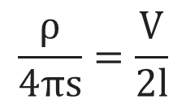
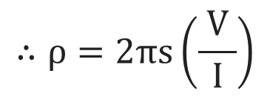
Four – Probe Method
$$\frac{ρ}{4πs}=\frac{V}{2l}$$
$$∴ρ=2πs\left(\frac{ V }{I}\right)$$
Where, V = potential difference between inner probes
I = current through outer probes
S = spacing between probes
ρ = Resistivity of sample

Slide 14
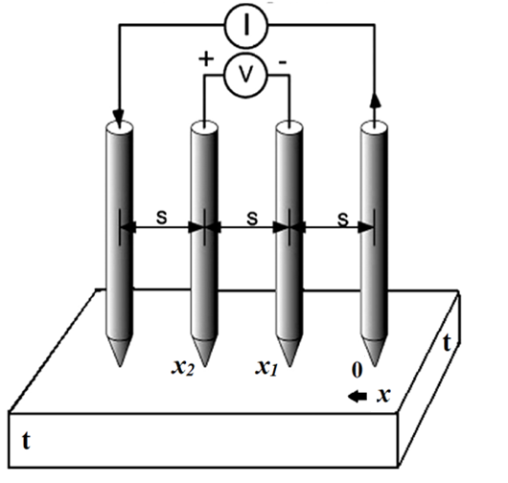
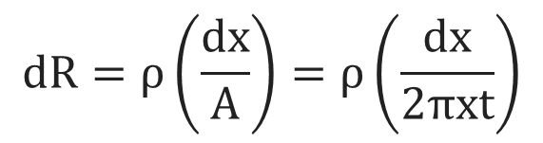
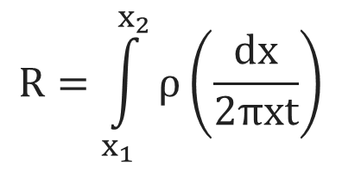
Four – Probe Method
Case: 2 For thin sheet (when t << s)
For a very thin sample, we get current rings instead of
hemispheres. i.e., current travels in short cylindrical
shell of equipotential.
So the area will be the area of the cylinder i.e., A = 2πxt
$$dR=ρ\left(\frac{dx}{A}\right)=ρ\left(\frac{dx}{2πxt}\right)$$
Integrating both sides,
$$R=\int_{x_{1}}^{x_{2}}{ρ}\left(\frac{dx}{2πxt}\right)$$

Slide 15

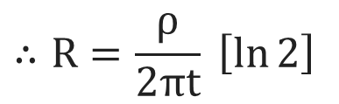
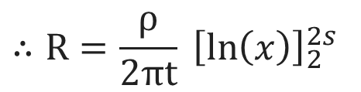
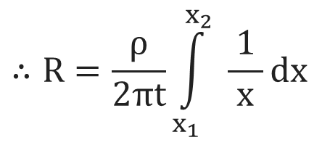
Four – Probe Method
$$R=\int_{x_{1}}^{x_{2}}{ρ}\left(\frac{dx}{2πxt}\right)$$
$$∴R=\frac{ρ}{2πt}\int_{x_{1}}^{x_{2}}{ \frac{ 1 }{x}}dx$$
$$∴R=\frac{ρ}{2πt} {\left[ln\left(x\right)\right]}_{2}^{2s}$$
$$∴R=\frac{ρ}{2πt} \left[\ln{2}\right]$$
Due to super position of current, at the outer two probes,
we have

Slide 16

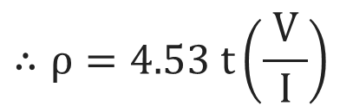
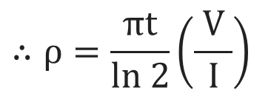
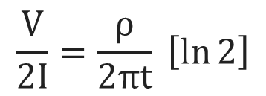
Four – Probe Method
$$R=\frac{V}{2l}$$
By Comparing above two equation we get,
$$\frac{V}{2I}=\frac{ρ}{2πt} \left[\ln{2}\right]$$
$$∴ρ=\frac{πt}{ln 2}\left(\frac{ V }{I}\right)$$
$$∴ρ=4.53 t\left(\frac{ V }{I}\right)$$
Above expression gives the value of resistivity for thin film.

Slide 17
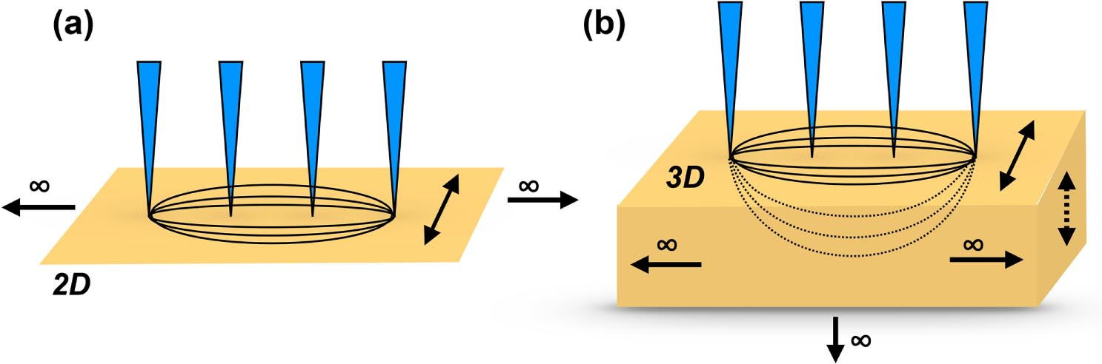
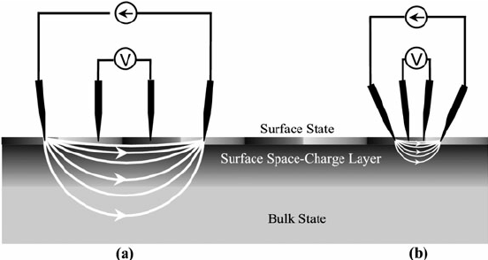
Four – Probe Method

Slide 18
Vander Pauw measurement

Slide 19
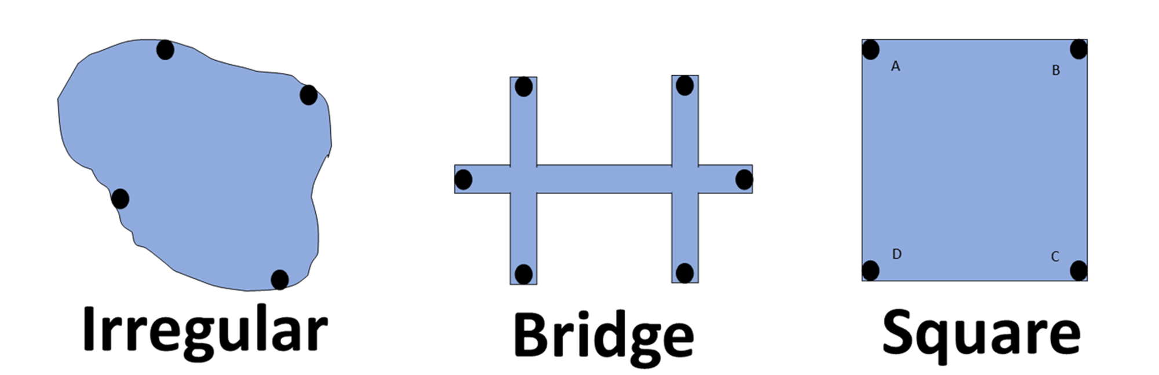
Vander Pauw measurement
The van der Pauw method involves applying a current and measuring voltage using four small
contacts on the circumference of a flat, arbitrarily shaped sample of uniform thickness.
This method is particularly useful for measuring very small samples because geometric spacing
of the contacts is unimportant. Effects due to a sample's size, which is the approximate probe
spacing, are irrelevant.

Slide 20
Vander Pauw measurement
From the measurement made, the following properties of a material can be calculated
1) Resistivity of the material
2) Doping type
3) Carrier density of majority charge carriers
4) Mobility of charges carriers.

Slide 21
Vander Pauw measurement
The basic requirements of the method are as under:
1) All the contacts should be at the periphery of the sample.
2) Size of the contacts should be negligibly small as compared to that of the sample.
3) All the contacts should be Ohmic.
4) Sample should be very thin as compared to its area.
5) Surface of the sample should be singly connected i.e. the sample should be free from steps and
discontinuities.
6) Sample should be flat so that the sample surface and contacts lie in the sample plane.

Slide 22
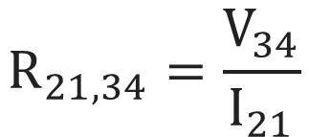
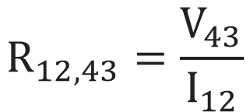
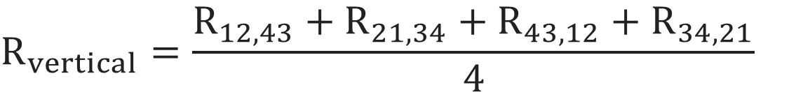
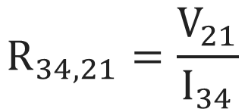
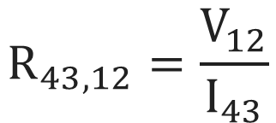
Vander Pauw measurement
1
4
$$R_{12,43}=\frac{V_{43}}{I_{12}}$$
I₁₂
V₄₃
$$R_{21,34}=\frac{V_{34}}{I_{21}}$$
$$R_{43,12}=\frac{V_{12}}{I_{43}}$$
2
3
Vertical Resistance Measurement
$$R_{34,21}=\frac{V_{21}}{I_{34}}$$
$$R_{vertical}=\frac{R_{12,43}+R_{21,34}+R_{43,12}+R_{34,21}}{4}$$

Slide 23
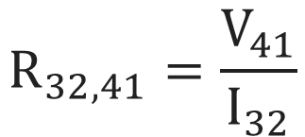
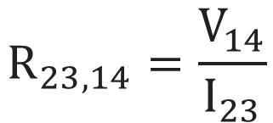
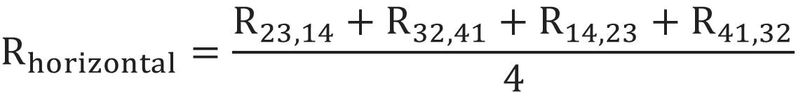
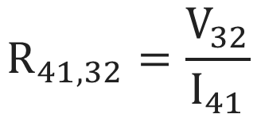
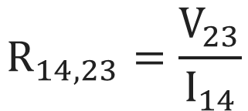
Vander Pauw measurement
V₁₄
$$R_{23,14}=\frac{V_{14}}{I_{23}}$$
1
4
$$R_{32,41}=\frac{V_{41}}{I_{32}}$$
2
3
$$R_{14,23}=\frac{V_{23}}{I_{14}}$$
I₂₃
$$R_{41,32}=\frac{V_{32}}{I_{41}}$$
Horizontal Resistance Measurement
$$R_{horizontal}=\frac{R_{23,14}+R_{32,41}+R_{14,23}+R_{41,32}}{4}$$

Slide 24
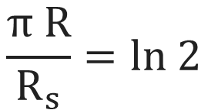

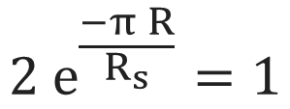
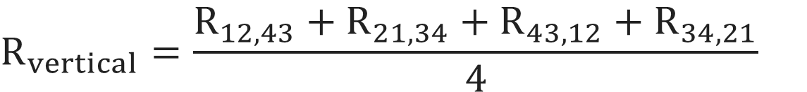
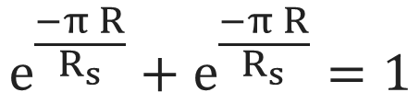
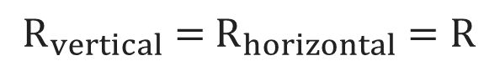
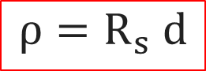
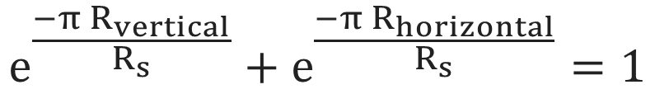
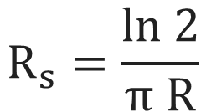
Vander Pauw measurement
$$R_{vertical}=\frac{R_{12,43}+R_{21,34}+R_{43,12}+R_{34,21}}{4}$$
$$R_{horizontal}=\frac{R_{23,14}+R_{32,41}+R_{14,23}+R_{41,32}}{4}$$
The Vander Pauw formula becomes
$${2 e}^{\frac{−π R}{R_{s}}}=1$$
$$e^{\frac{−π{ R}_{vertical}}{R_{s}}}+e^{\frac{−π{ R}_{horizontal}}{R_{s}}}=1$$
$$ρ=R_{s} d$$
$$\frac{π R}{R_{s}}=ln 2$$
$${ R}_{vertical} ={ R}_{horizontal} =R$$
$$R_{s}=\frac{ln 2}{π R}$$
$$e^{\frac{−π R}{R_{s}}}+e^{\frac{−π R}{R_{s}}}=1$$

Slide 25
Hall effect

Slide 26
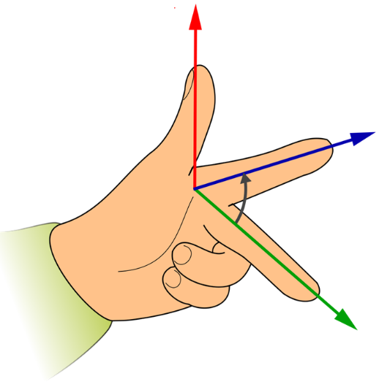
Hall effect
V
N
N
e⁻
e⁻
e⁻
e⁻
e⁻
e⁻
e⁻
X
e⁻
e⁻
e⁻
e⁻
e⁻
S
e⁻
e⁻
e⁻
-Z
B
Y
I
F
Z
I
S
I

Slide 27
Hall effect
Hall Effect: If a sample of conductor or semiconductor carrying current I is placed in a transverse
magnetic field B, an electric field E induced in a direction perpendicular to both
current and magnetic field. This phenomena is known as Hall effect and generated
voltage is known as Hall voltage V_{H}.
In order to derive the equation of Hall mobility first we will derive the equation of Hall coefficient.
Magnetic field vector ‘B’ is applied on this sample along y-axis. Now if a current ‘I’ is passed
through the sample in the direction of x-axis, charge carriers (in this case we assume electrons)
will drift with drift velocity ‘v_{d}’ in the opposite direction ‘-z’. Magnetic force ‘F_{B}’ acts on each
drifting electron, pushing it toward the left edge of the sample.
$$F_{B} = − e \left(v × B\right)= − B e v sin \left(90°\right)=− B e v ………(1)$$

Slide 28
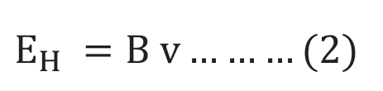



Hall effect
$$F_{B} = − B e v ………(1)$$
The Lorentz force is exerted on electrons in the negative –Z direction and causes a negative
charge to accumulate at the left edge of the sample. Moreover, the right edge of the sample
becomes positively charged due to loss of electrons. Therefore, a potential difference causes a
field E_{H} in negative –Z direction.
Where n is number of carrier concentration, comparing
equation (2) & (3)
In the equilibrium condition,
$E_{H} =B v………(2)$
$$E_{H} = \frac{B{ J}_{x}}{ne}………(4)$$
The current density is given by,
Hall effect is explained by Hall coefficient,
$$\left.J = n e v………(3\right)$$

Slide 29




Hall effect
$E_{H} = R_{H} B J_{x}………(5)$
$$where, R_{H} =\frac{1}{ne}$$
As the electric field in n-type semiconductor is established in negative –z direction value of Hall
coefficient becomes.
$$R_{H} = −\frac{E}{B J_{x}} = −\frac{1}{n e}………(6)$$
Value of Hall coefficient (R_{H}) is negative for n-type semiconductor.
In case of p-type semiconductor current is due to majority charge carriers holes, in that case
$$R_{H} = \frac{E}{B J_{x}} = \frac{1}{p e}………(7)$$
In case of p –type semiconductor value of Hall coefficient (R_{H}) is positive.

Slide 30





Hall effect
$\text{Determination} \text{of} \text{value} \text{of} \text{Hall} \text{coefficient}\text{:}$
$E_{H} = R_{H} B J_{x}………(5)$
Hall voltage generates Hall electric field (E_{H})
V
N
$$E_{H}= \frac{V_{H}}{t}$$
e⁻
e⁻
e⁻
e⁻
e⁻
$$\left.V_{H}= E_{H} t………(8\right)$$
Substituting value of E_{H} from equation (5)
S
$$V_{H}= R_{H} B J_{x} t$$
I
If w is the width of the semiconductor, then its cross-
section area (A) will be wt and the current density,
$$J_{x}= \frac{I}{w t}$$

Slide 31







Hall effect
$$V_{H}= \frac{R_{H} B t I }{w t}$$
Determination of Hall mobility
In case of n-type semiconductor value of conductivity is
given by,
$$V_{H}= \frac{R_{H} B I }{w}$$
$$σ_{e}= n_{e} e μ_{e}$$
$${Therefore, R}_{H}= \frac{V_{H} w }{B I}………(9)$$
$$Therefore, μ_{e}= \frac{σ_{e} }{n_{e} e}$$
The value of hall voltage is
opposite for n-type and p-type
semiconductor.
We know for the n-type semiconductor
$$R_{H} =−\frac{1}{n e}$$
$$\text{Hence}\text{,} μ_{e}=− σ_{e} R_{H}………(10)$$

Slide 32


Hall effect
Similarly, for p-type semiconductor
$$R_{H} =\frac{1}{n e}$$
$$μ_{h}= σ_{h} R_{H}………(11)$$
The Hall mobility $μ_{h}$ is defined as the product of Hall coefficient (R_{H}) and conductivity ($σ$).

Slide 33
Deep level Transient Spectroscopy (DLTS)

Slide 34

Deep level Transient Spectroscopy (DLTS)
Conduction Band
e⁻
e⁻
Shallow Level
Close to the edges of bandgap. Use as dopant
e⁻
Deep Level
e⁻
Close to the middle of bandgap. Use as trap centre where electrons and holes recombines.
Valence Band

Slide 35

Deep level Transient Spectroscopy (DLTS)
Conduction Band
Consider asymmetric diode. (one side is heavily doped compared to
other side).
e⁻
e⁻
e⁻
e⁻
Capacitance
(Storage of charge)
Valence Band

Slide 36

Deep level Transient Spectroscopy (DLTS)
1.
C
Space charge region (Depletion region)
No free charge carrier (Trap (t) < 0) (Empty traps)
t →
2.
C
t →
Minority charge carrier (Trap (t) = 0)
(Traps are filled)

Slide 37

Deep level Transient Spectroscopy (DLTS)
3.
C
Forward Bias
(Trap (t) = 0⁺)
Voltage in pulse form
t →
Defects starts to emit charge carriers due to thermal emission.
4.
Here, capacitance starts decreases and steadily comes in normal state.
C
t →

Slide 38
UV – Vis Spectroscopy

Slide 39


UV – Vis Spectroscopy
UV- Vis Spectroscopy is related to the interaction of light with matter.
As light is absorbed by matter, the result is an increase in the energy
content of the atoms or molecules.
This method is used to measure the energy band gap of different
materials, by measuring absorption spectrum.
$$UV−Vis (λ)=2000−8000 Å$$

Slide 40
UV – Vis Spectroscopy
Bandgap refers to the energy difference between bottom of conduction band and top of valence
band, through which electrons are able to jump from one band to another.
The instrument used in UV-Vis spectroscopy is called UV-Vis spectro-photometer.
It measure the intensity of light after passing through a sample (I), and compares it to the
intensity of light before it passes through the sample (I₀).
A light of wavelength (λ) and energy (hv) is made to pass through monochromator to get a
parallel beam.

Slide 41



UV – Vis Spectroscopy
$$Transmittance (T)=\frac{ I }{I_{0}}$$
$$Absorption \left(A\right)=log\frac{{ I}_{0} }{I}$$

Slide 42






UV – Vis Spectroscopy
The Tauc’s relation is used to determine the bandgap (E_{g}) in semiconductor.
$$α hv={\left.A (hv−E_{g}\right)}^{n}$$
$$α=\frac{{\left.A (hv−E_{g}\right)}^{n}}{hv}$$
$${\left(α hv\right)}^{\frac{1}{n}}=A^{\frac{1}{n}} hv−{A^{\frac{1}{n}} E}_{g}$$
$$T=Transmittance= \frac{I}{I_{0}}$$
$$Where, α=absorption coefficient and is given by α=\frac{ln\left(\frac{1}{T}\right) }{x}$$
$$x=Thickness of the sample$$
n = 1/2, 2, 3/2, and 3 for direct allowed, indirect allowed, direct
forbidden, and indirect forbidden transitions respectively.

